Slide 1

AuthenticateMe
FYP-21-S1-02
Tan chun ying, Alicia
Yap yong ting terrence
Joel Teo han wen
Chea cui hui
Tng min li
Typing Habit Gesture Authentication System

Slide 2
Table of contents
Project Requirement Interpretation
Target Audience
Market Research
Methodology
System Requirements
Design Specification
Website Application Set-Up
Website Application
Trailer Video
Final Application Demonstration

Slide 3
Project Requirement Interpretation

Slide 4
Project requirements interpretation
Convenient, easy to use website application
Able to authenticate users based on typing habits
Training of model (Machine learning)

Slide 5
Target Audience

Slide 6
Target audience
AuthenticateMe is targeted mainly at web developers that want to implement a primary authentication means with an additional layer of security using typing biometrics.
Our system focuses on typing biometrics as an authentication system without the end user having to do something actively. Thus, our targeted audience are able to implement a new type of authentication with an additional layer of security to protect their users better.
Notes:
AuthenticateMe is targeted at web developers that want to explore using a new type of authentication other than the usual password-based systems.
So the problem with password-based systems are that users have the responsibility to create a reasonably strong passwords. This places 2 burdens on them: creating the password itself, and having to remember the password. Also, users tend to forget their password, or reuse them across all their accounts due to convenience.
Our system aims to relieve users of that responsibility by authenticating them through their typing habits. Typing habits are measured with milliseconds precision and would require quite an enormous effort to replicate. Since they are hard to replicate, it provides added security which these web developers can use to better protect their users.

Slide 7
MARKET RESEARCH

Slide 8
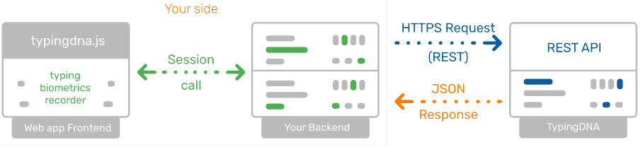
TypingDNA
TypingDNA uses propietary typing biometrics authentication technology.
Typing DNA aims to replace 2FA codes, such as SMS codes, with typing biometrics.
TypingDNA uses a 3-step approach for authentication.
A front-end recorder records users typing habits.
Data is sent to API for analysis.
API returns verification of authentication.
Notes:
3-step process for authentication
1. One of their recorders is included in the front-end of an application to collect typing patterns from end-users.
2. Collected typing patterns are submitted to their API for enrollment or analysis, along with a User ID.
3. The Authentication API will return a verification or enrollment JSON response depending on the action performed.
In the case of a verification, the API will return an actionable result to your application, along with score.
TypingDNA recommends to save at least 3 typing patterns per user in order to perform accurate authentications.
State of art authentication engine
TypingDNA Verify uses proprietary typing biometrics authentication technology coupled with keyphrases of high complexity regarding the number of different characters,
the way they are dispersed throughout the keyboard layout, the vertical and horizontal travel and other factors. They use AI not only in the authentication technology, but also to select best keyphrases which enables higher matching accuracy on much shorter texts.

Slide 9
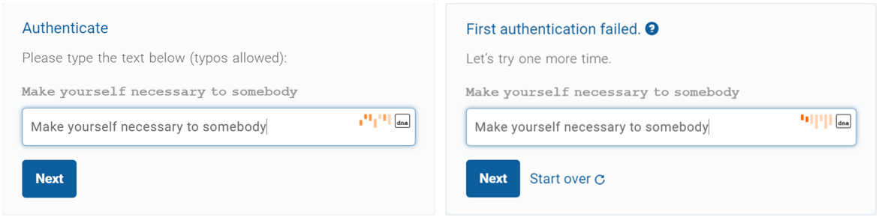
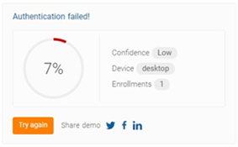
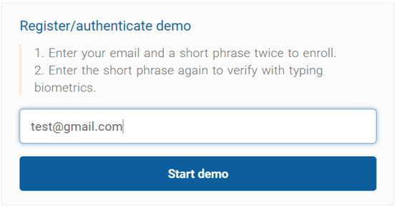
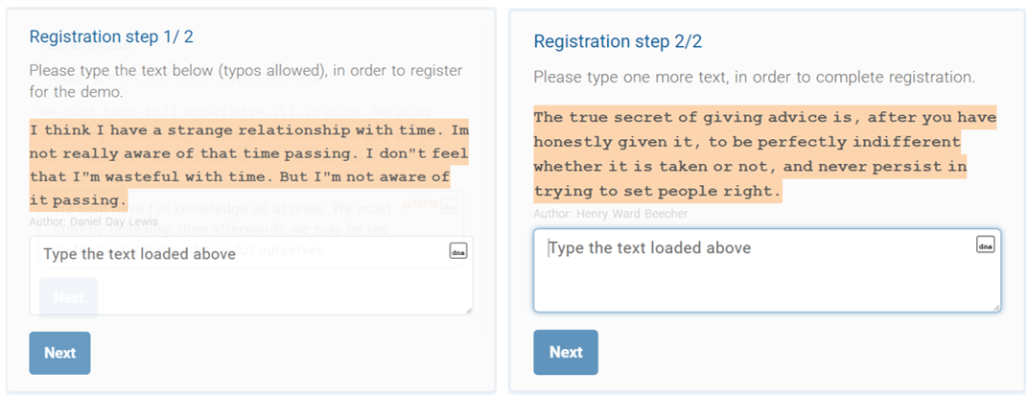
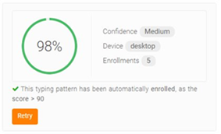
TypingDNA Demo
Short Phrase
Verification
Different Text

Slide 10
TypingDNA vs our project
Typing DNA uses the same short phrase for multiple users and there might be an occurance in which there will be users with similar Typing biometrics.
Reduce the chances of having an occurance where it is similar to another user.
Each user is given a different sentence where it is only changed when you have recalibrated.
Recalibration allows us to have an allowance in which there might be instances when the user typing biometrics will change arubtly.
Recommends 3 typing patterns to produce accurate authentications.
Notes:
This slide is to highlight typingDNA being a 2FA option, but our goal is to replace password system.
User experience at core
The biggest disrupter of our time is UX. Whether we’re talking about companies like Google, Uber, Airbnb, Apple, the better user experience always made the company win over traditional solutions. At TypingDNA, their main focus is to solve user authentication by minimizing user effort and friction while producing a visible sense of protection.
Keep SMS costs low
TypingDNA only sends SMS codes when the users enrol into the system, if they fail to verify, or if you bypass our verification.
This will keep SMS costs low, at an estimated 10%, or lower.
- Although the full amount of SMS through traditinal means and this way may not have any difference in price, it is still lesser.

Slide 11
METHODOLOGY

Slide 12
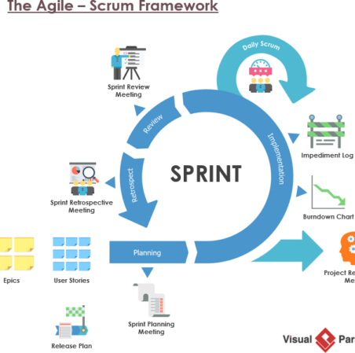
Methodology
Agile SCRUM was chosen as the development methodology.
SCRUM allows the developing team to determine the direction of the project.
Collaboration with stakeholders allows the development team to better understand the need of the users and adjust the system accordingly.
Scrum consists of repeating periods of 2-3 weeks, known as sprints.
For each sprint, a chosen number of user stories are discussed and incorporated into the system.
This process is repeated until the system is complete.
Notes:
Talk about agile
Scrum allows the developing team to determine the direction of the project as they know the best way to get to the solution.
Through collaboration with stakeholders, the development team can better understand the need of the users and adjust the system accordingly.
Scrum consists of repeating periods of 2-3 weeks where a chosen number of user stories are discussed and incorporated into the system.
The client would discuss the specifics of the user stories with the development team.
After the discussion, the development team would then go on to implement the items discussed through coding and testing.
This process is repeated until the system is complete.
In this way, the development team can ensure that requirements are consistent with the requirements of the client throughout the process.
No changes to the requirement should be made during the sprints as they should be focused on development of the system.

Slide 13
SYSTEM REQUIREMENT

Slide 14
System Requirements
Functional – Website application
Allows user to sign up for an account and register their typing habits
Allows user to log in and authenticate themselves (at the login page)
Allows user to log out and exit the application.
Register user account based on 4 steps:
1st: Enter username, name and email, date of birth, security question and security answer.
2nd: Type sentence according to generated sentence.
3rd: Typing habit is recorded.
4th: Repeat 2nd and 3rd steps 10 times

Slide 15
System Requirements
Functional – Website application
Authenticate user logins based on 3 steps:
1st: Correct username
2nd: Correct Input according to generated sentence
3rd: User is authenticated if typing habit recorded is within the user’s threshold.
Logout by using the logout icon and successfully exit the application

Slide 16
DESIGN SPECIFICATION

Slide 17
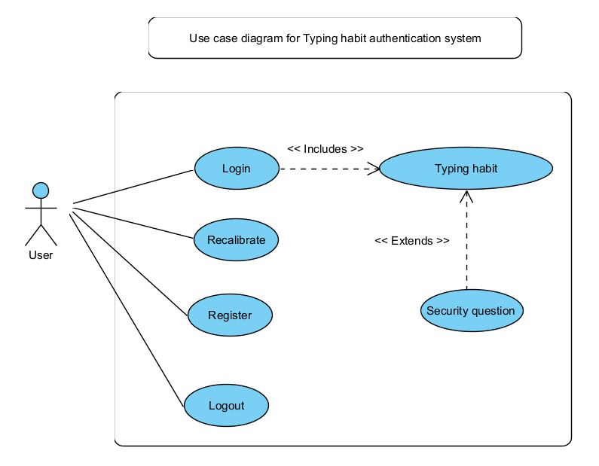
Design Specifications
Use case diagram

Slide 18
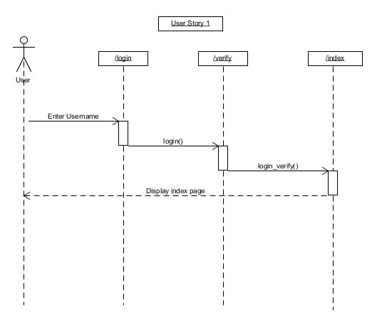
Design Specifications
Sequence diagram
User story 1
As a user, they should be able to get authenticated so that they can log in to the application.

Slide 19
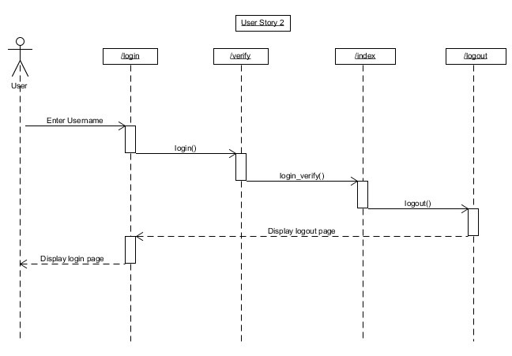
Design Specifications
Sequence diagram
User story 2
As a user, they should be able to log out so that they can exit the application safely.

Slide 20
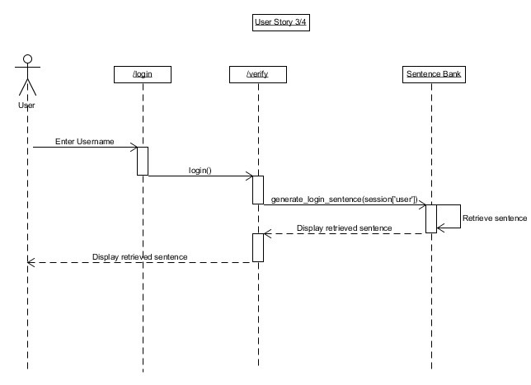
Design Specifications
Sequence diagram
User story 3
As a user, they should be able to enter their typing habits so that they can be authenticated.
User story 4:
As a user, they should be able to view a sentence upon login so that they can be able to type and authenticate themselves.

Slide 21
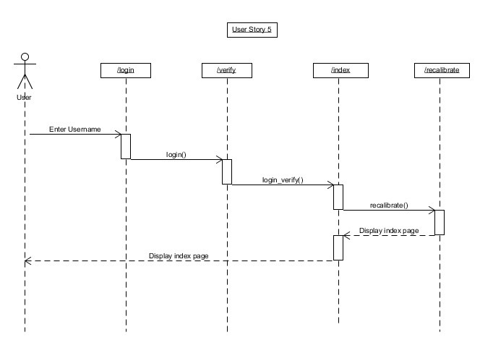
Design Specifications
Sequence diagram
User story 5
As a user, they should be able to re-calibrate their typing habits so that they are able to pass the authentication system even if their typing habits change.

Slide 22
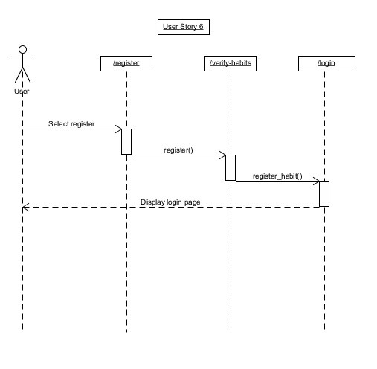
Design Specifications
Sequence diagram
User story 6
As a user, they should be able to register account so that they can log in to the system.

Slide 23
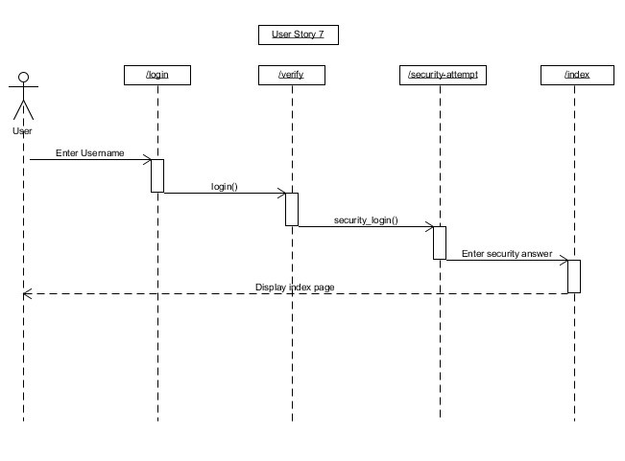
Design Specifications
Sequence diagram
User story 7
As a user, they should be able to authenticate themselves using a security answer in case their typing habits change.

Slide 24
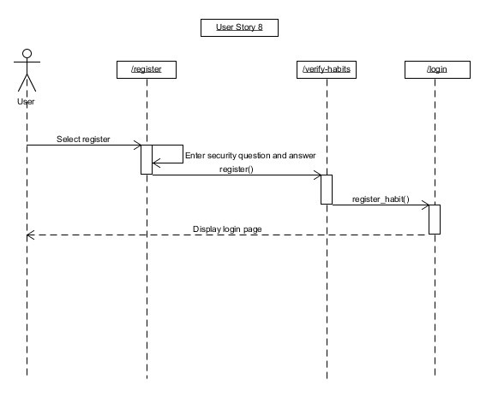
Design Specifications
Sequence diagram
User story 8
As a user, they should be able to register their security question and answer so as to be able to log into their accounts in the future should their typing habit authentication fail.

Slide 25
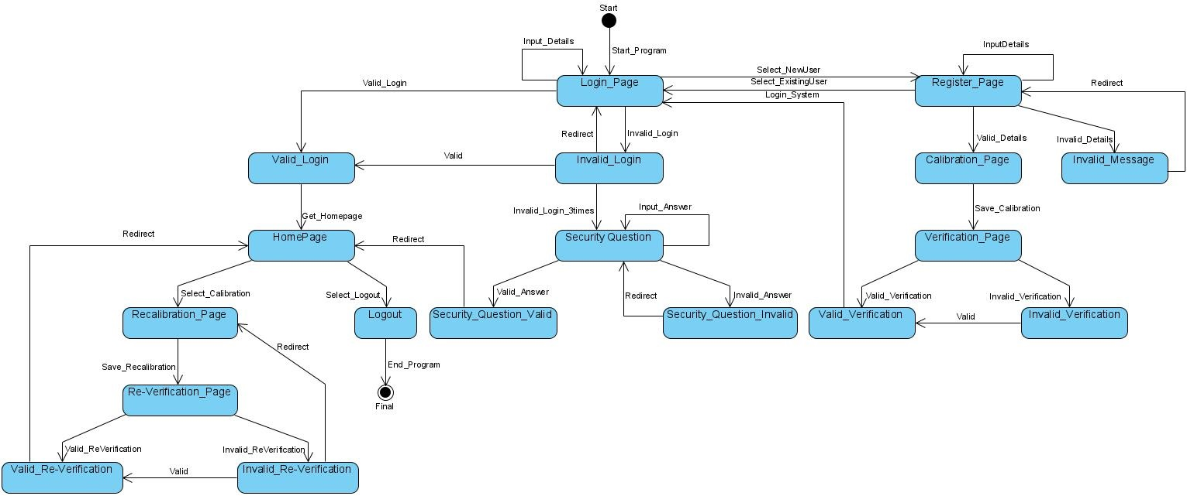
Design Specifications
State diagram

Slide 26
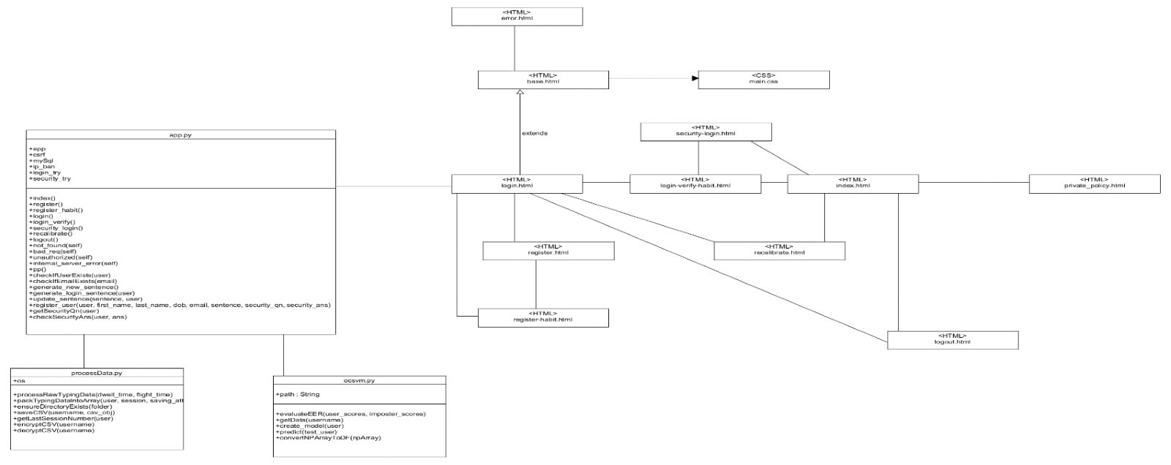
Design Specifications
Class diagram

Slide 27
Website application set-up

Slide 28
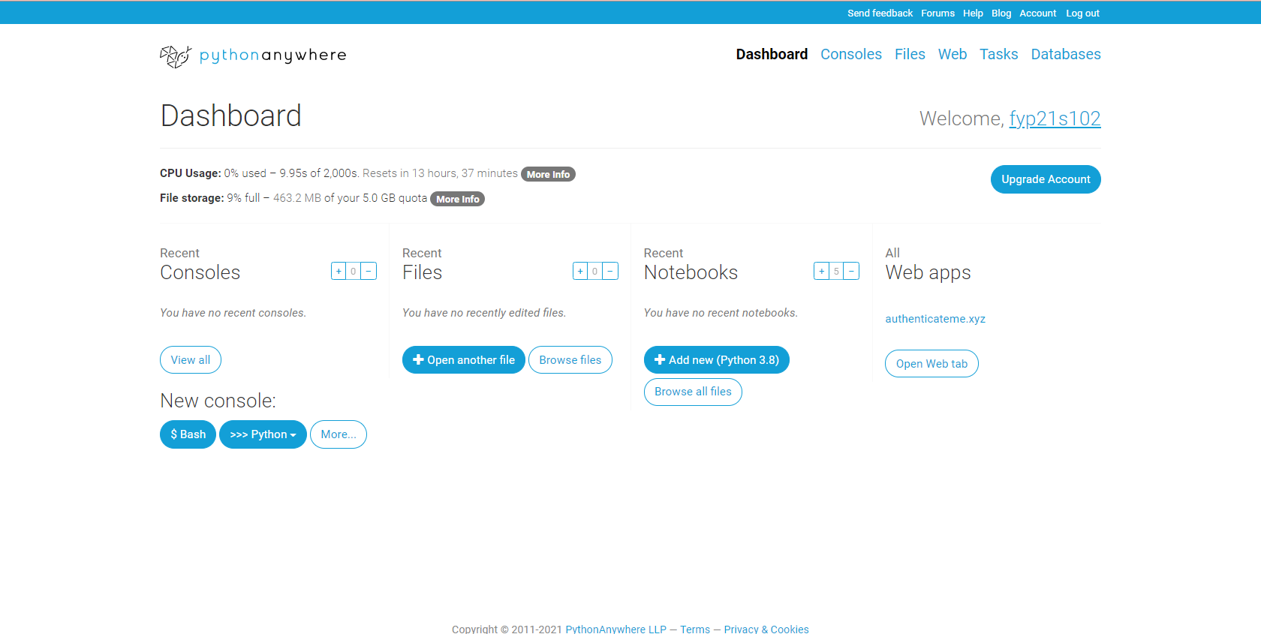
Website application set-up
1. Hosting - Pythonanywhere

Slide 29
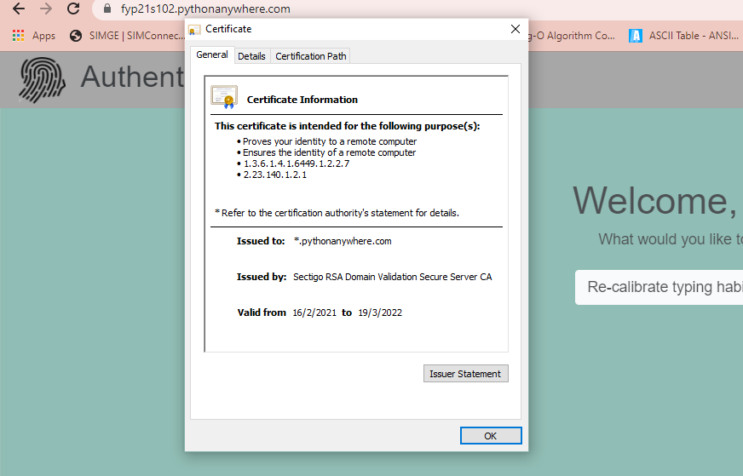
Website application set-up
2. SSL certificate - Pythonanywhere

Slide 30
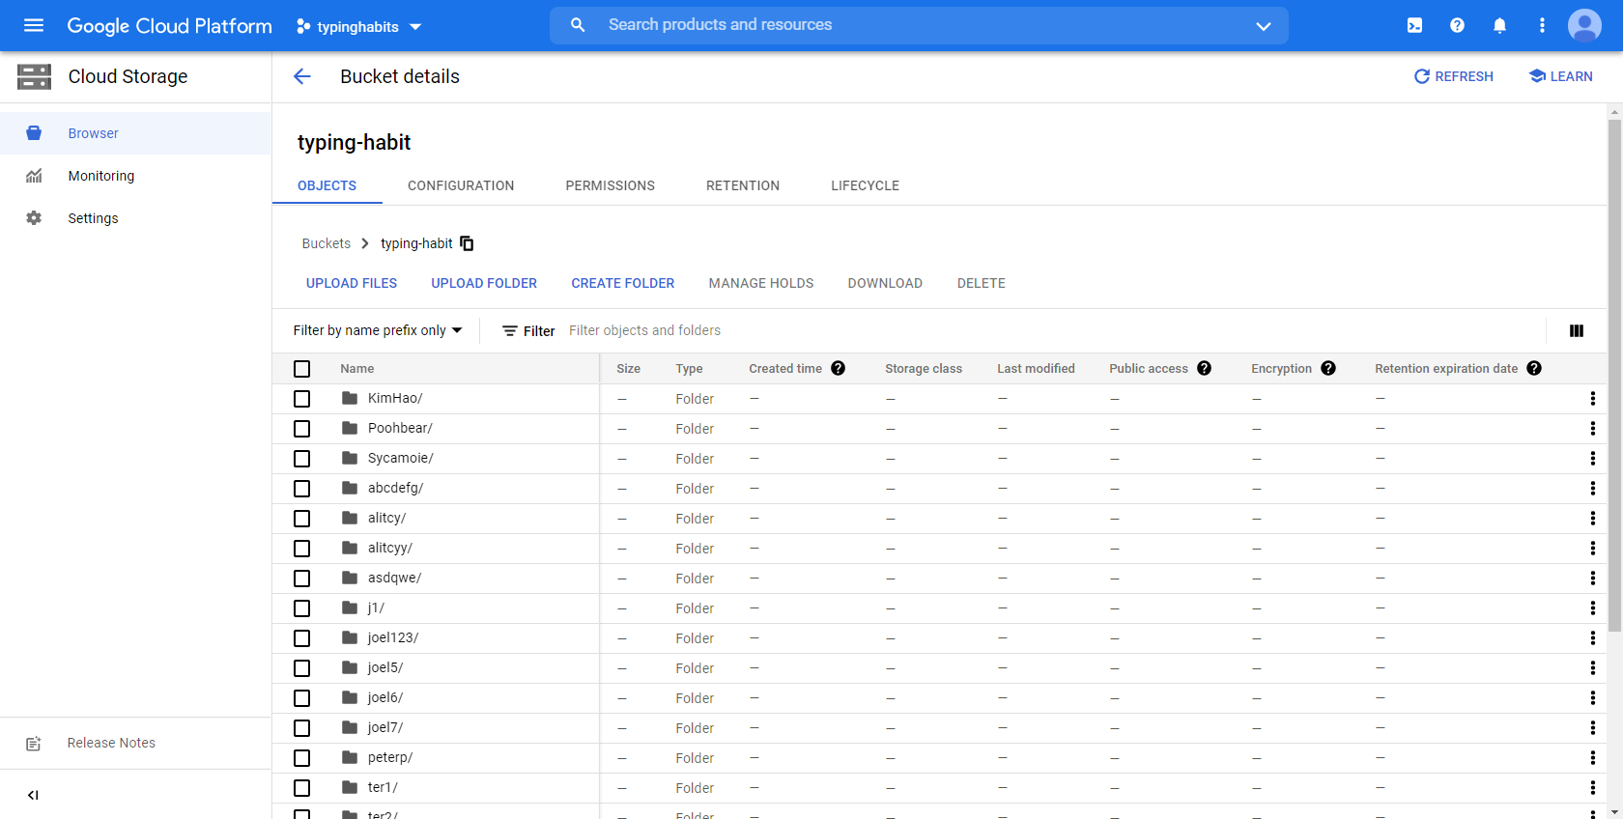
Website application set-up
3. File System – Google Cloud

Slide 31
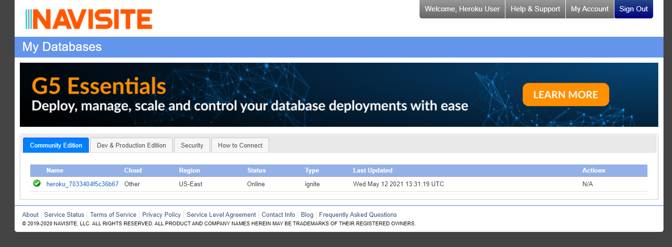
Website application set-up
4. Database – ClearDB

Slide 32
Website application

Slide 33
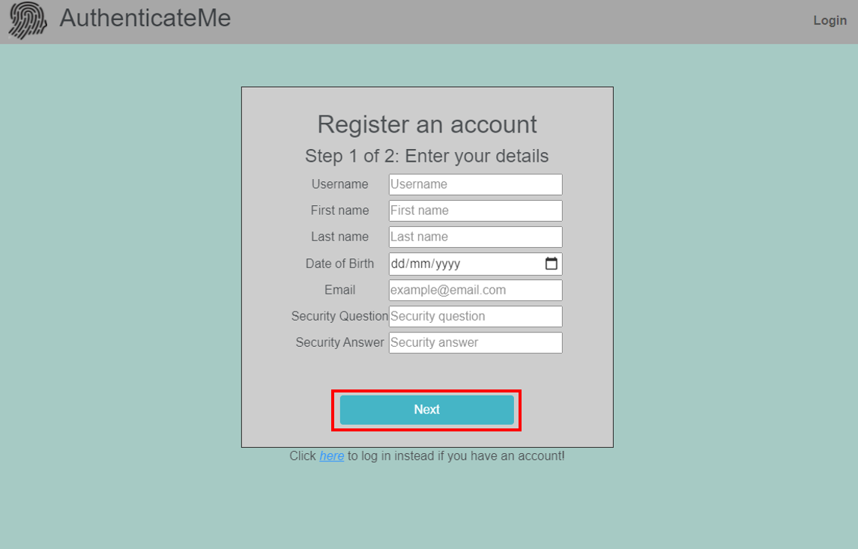
Website application – Registration Page

Slide 34
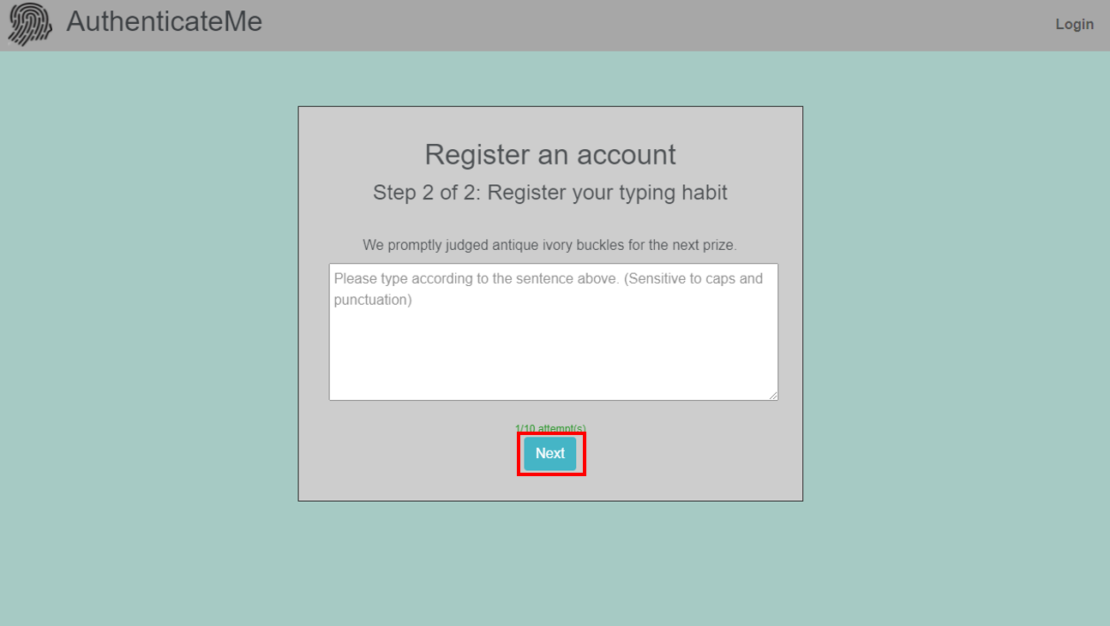
Website application – Registration Page

Slide 35
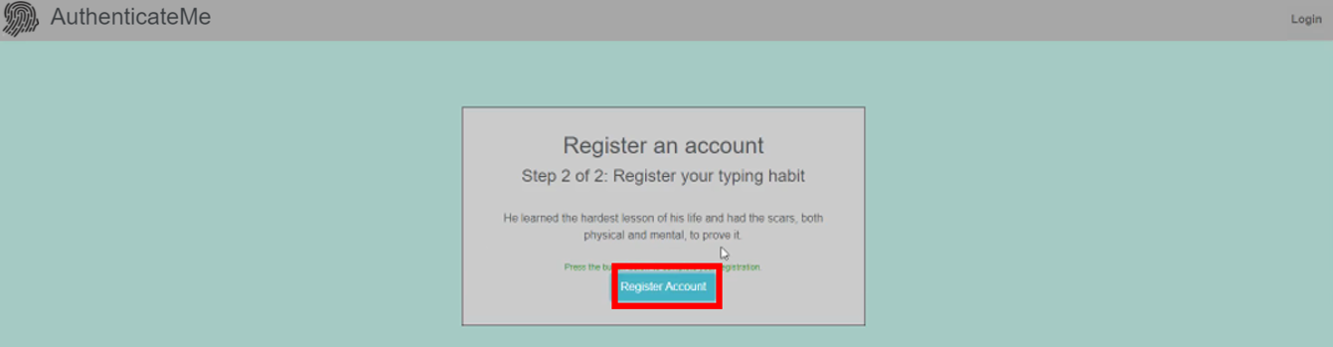
Website application – Registration Page

Slide 36
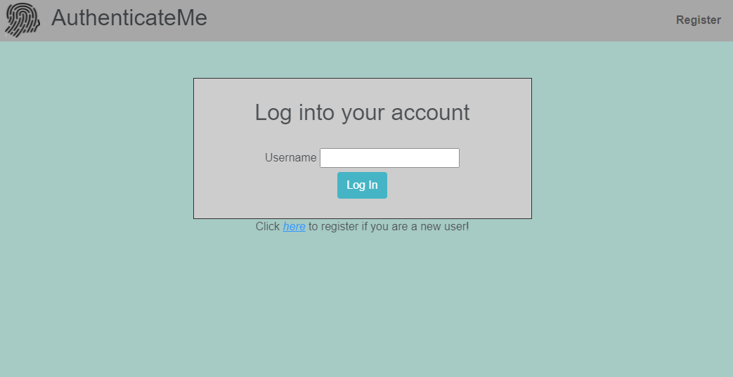
Website application – Login Page (via typing habits)

Slide 37
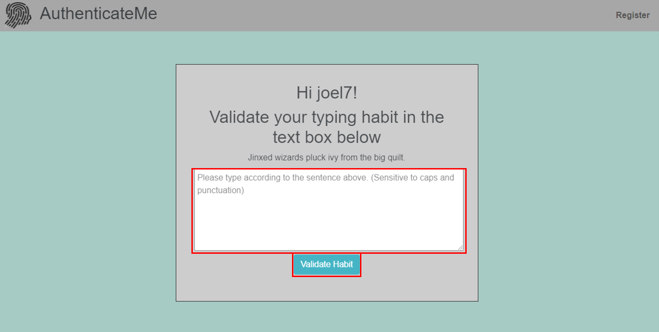
Website application – Login Page (via typing habits)

Slide 38
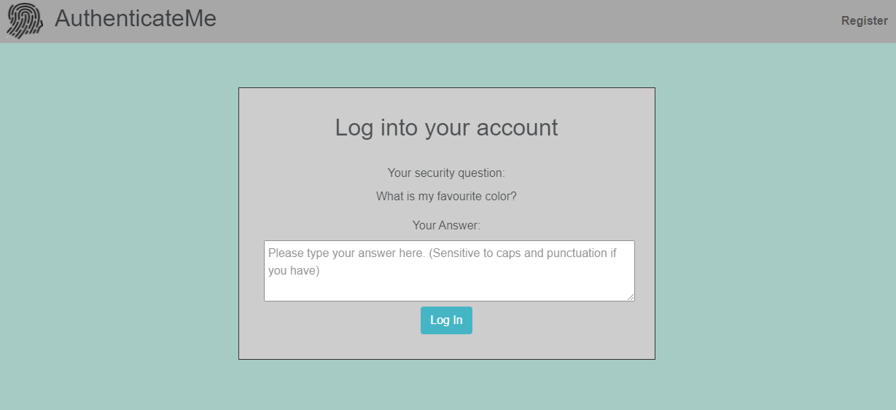
Website application – Login Page (via security question)

Slide 39
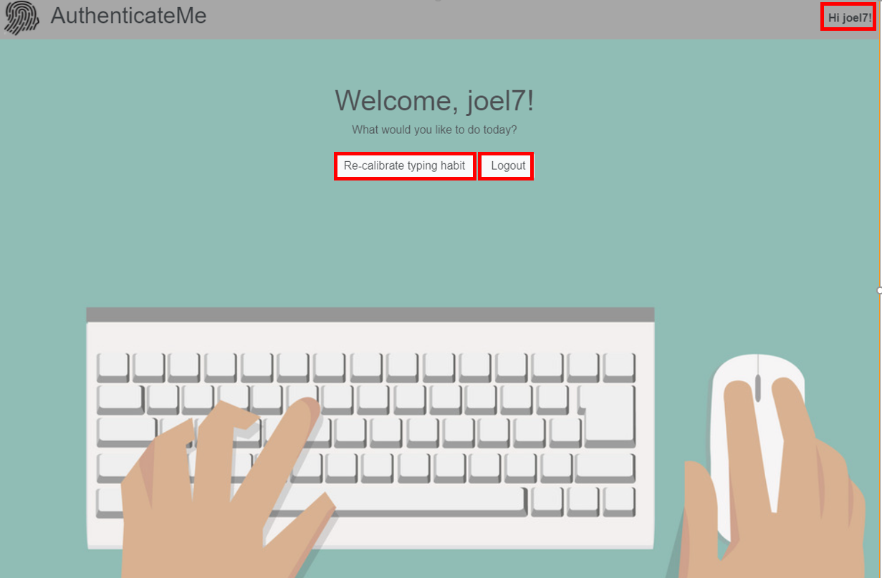
Website application – Index Page

Slide 40
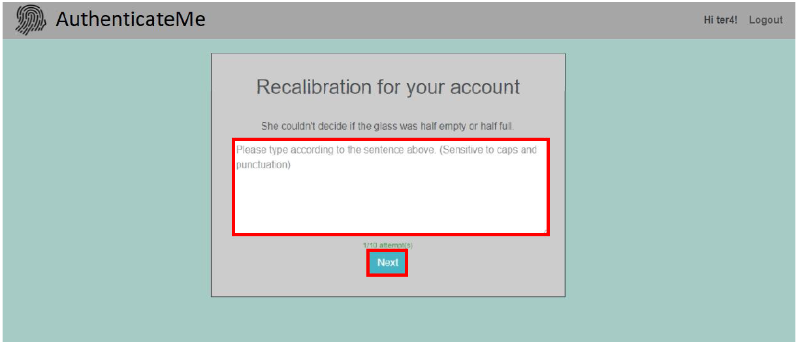
Website application – Recalibration Page

Slide 41
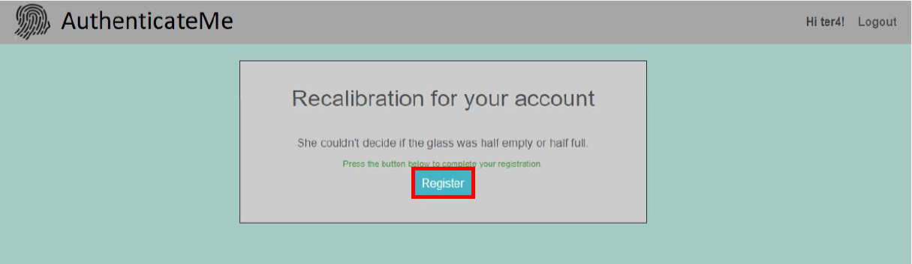
Website application – Recalibration Page

Slide 42
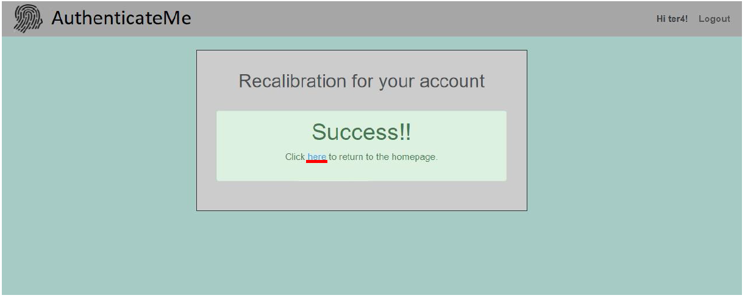
Website application – Recalibration page

Slide 43
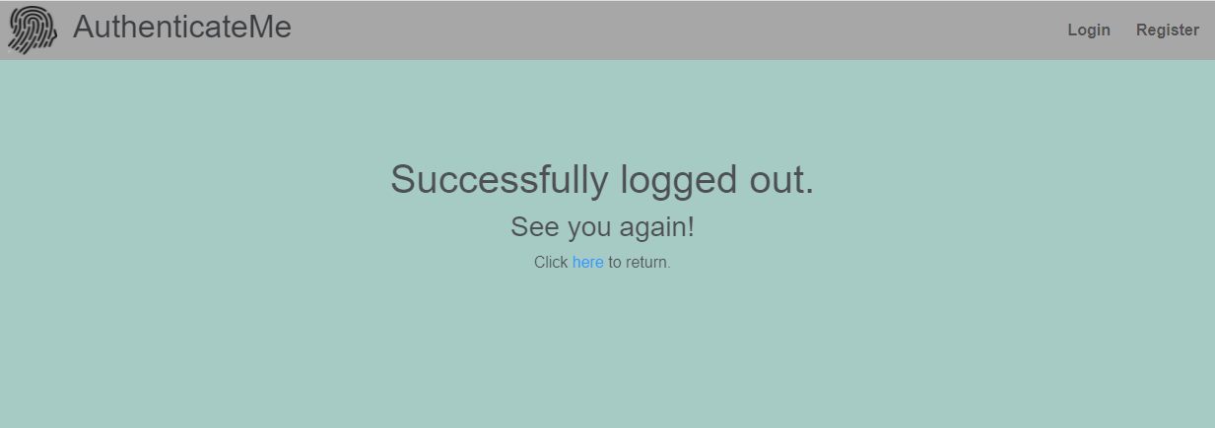
Website application – Logout page

Slide 44
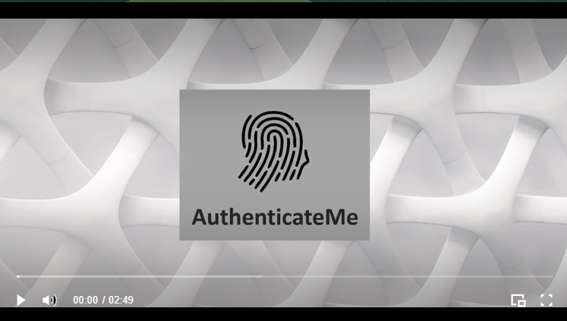
Trailer video
https://fyp21s102.wixsite.com/fyp21s102/our-product

Slide 45
Final application demonstration

Slide 46
The end!

